Slide 1
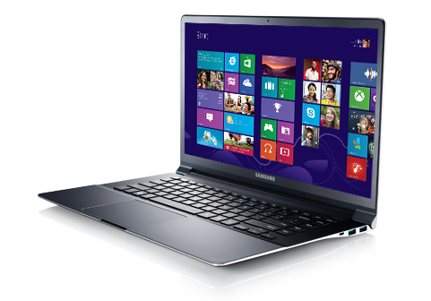
LAPTOP THEFT DETECTION SYSTEM
JOMO KENYATTA UNIVERSITY OF AGRICULTURE & TECHNOLOGY SCHOOL OF ELECTRICAL, ELECTRONIC AND INFORMATION ENGINEERING
DEPARTMENT OF ELECTRICAL, ELECTRONIC AND INFORMATION ENGINEERING
STUDENT: OGAYO GILL ERICK SUPERVISOR: MR. OLOO

Slide 2
Outline
Introduction
Problem statement
Justification
Literature review
Methodology
Project time-plan
Budget

Slide 3
INTRODUCTION
1
Let’s get started!

Slide 4
Introduction
Laptops have become an essential asset in today's digital age. So much of daily tasks depend on these devices.
They contain important data, meaning their value is an accretion of both the physical device itself and the data it contains.
This means laptops are at a high risk of being targeted by thieves.

Slide 5
PROBLEM STATEMENT
2
What problem is to be solved?

Slide 6
Problem Statement
In JKUAT, about 3 to 5 laptop theft cases are reported every month. This means about 40 laptops lost in a year.
The current means being deployed to tackle the issue are not very efficient.
The strategies are also mostly meant to recover the laptop once it’s been stolen.

Slide 7
Statistics of Laptop Theft in JKUAT
 | 2018 | 2019
Reported | 41 | 4*
Recovered | 0 | 0
Source: Digital Forensic Officer, JKUAT
Notes:
* As per 13th of February
100% of laptops lost are never recovered

Slide 8
98%
Percentage of stolen laptops never recovered

Slide 9

JUSTIFICATION
3
Why is this project needed?

Slide 10
Justification
It is retardant rather than redemptive
The proposed solution is cheap
The proposed solution is efficient and fast
The proposed system would inspire more confidence to laptop users
It will automate and digitize laptop theft logging
Other than laptops, this system could be used for other assets inventory
It can be modified and used for automated entry point
Notes:
This system does not attempt to recover the 98% we saw; it works to ensure they are not lost in the first place
It’s making use of smartphones that are already owned by individuals – the most expensive part of the system could be asset tags
It is faster than the current manual system
When users trust in a system then they are likely to accept it

Slide 11

OBJECTIVES
4
What is to be achieved?

Slide 12
Objectives
Main Objective
To design, develop and test a laptop theft detection system. Specific Objectives
To develop a system that allows students to report laptop theft using an Android application.
To develop a digitized university laptop inventory system.
To develop an ID/asset tag scanning system.
To develop an alert system that will notify security personnel of laptop theft as soon as they are reported.
To develop a system that will automate and digitize laptop theft logging.

Slide 13

LITERATURE REVIEW
5
What do existing studies show?

Slide 14
Existing solutions
Manual inventory at the gates and buildings
Use of laptop trackers
Backup of data
CCTV Surveillance
Data protection
User awareness amongst students

Slide 15
Literature Review
Existing measures
Physical security
Manual Records
CCTV Surveillance
GPS Tracking
Software trackers
User awareness

Slide 16
Literature Review
Classification of laptop theft prevention and recovery measures
User awareness
Physical security
Organizational policies
Technology
Data protection
Notes:
Explain the various categories
This classification can be broken down into a layer: laptop theft security layer

Slide 17
Laptop Theft Security Layer
Physical Security
User Awareness
Technology
Data protection
University Policies
Notes:
It defines the relationship between the various of laptop security
It has three major layers – the preventive layer, the mitigation layer, multi-layer
Next: Motives for laptop theft

Slide 18
Literature Review
Motives for stealing laptops
Quick cash
Elaborate laptop syndicates (illegal trade)
To steal sensitive or important data
Notes:
According to a 2019 Ponemon Institute Report, consumer data breach cost up to $183 for every record
Next: parting remark on laptop theft

Slide 19
Laptop theft is mostly a crime of opportunity and if the stakes can be made high and the targets hardened, the thieves could be deterred.

Slide 20

Proposed System
Android application
Web application
Server-side application

Slide 21
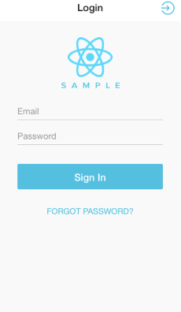
Android Application
Key Features
User registration
Asset tag/ID scanning & verification
Laptop theft reporting

Slide 22
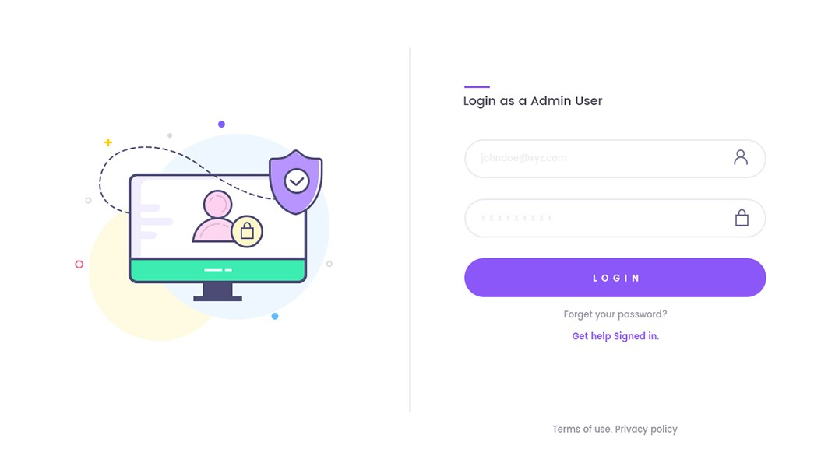
Web Interface
Key Features
Laptop inventory management
Case flagging
Theft notification (administrators & security)

Slide 23

Server-side application
Logic handling
Database
Application Programming Interface

Slide 24
METHODOLOGY
6
How is this going to be achieved?

Slide 25
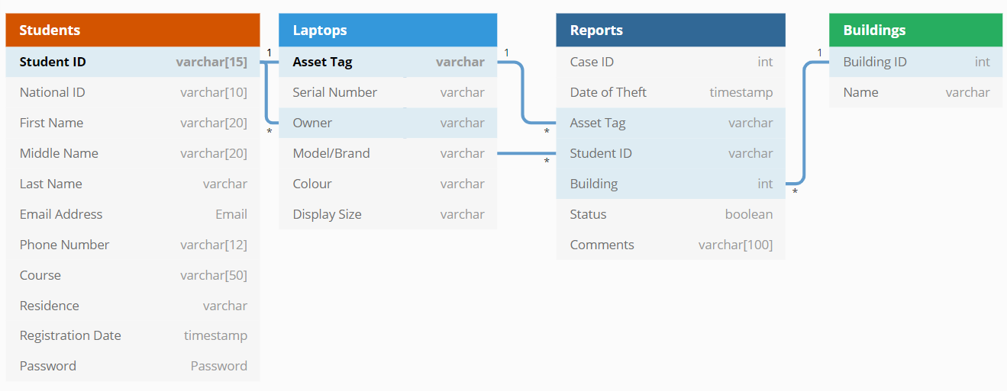
Methodology
Entity relationship diagram
Notes:
Relationships
One-to-many: Students – Laptops
One-to-many: Laptops-Reports
One-to-many: Students – Reports
One-to-many: Buildings - Report

Slide 26
Notes:
The checking in/checking out flow chart

Slide 27
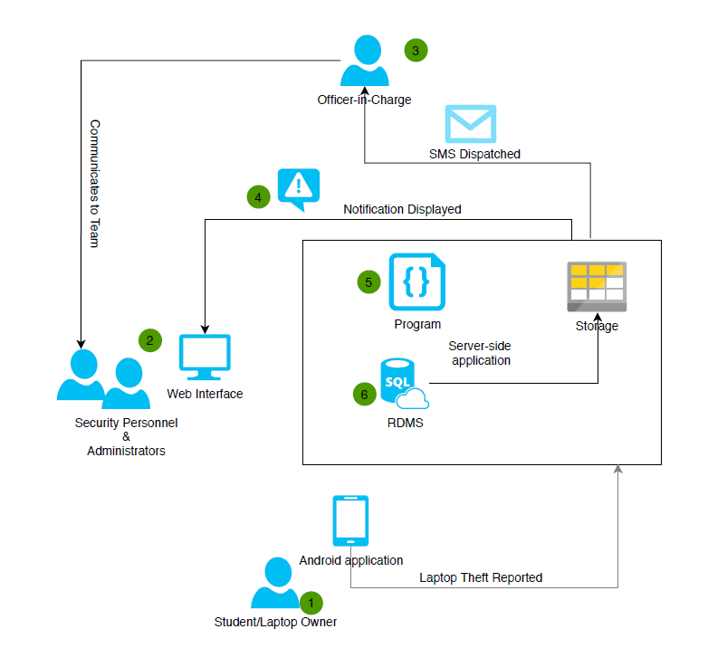
Notes:
Laptop theft reporting flow diagram

Slide 29
Methodology
Tools and Skills
Android (Java)
MySQL
Back-end programming (Code Igniter)
Front-end programming (React JS)

Slide 30
Expected Results
A distributed database of the laptop ownership inventory
A system that would allow security personnel to verify laptop ownership at the gates and major buildings.
A system that will allow laptop owners to quickly report in the event of laptop loss.
A system that will digitize and automate laptop theft logging.
A system that will enable authority gain insight into laptop theft cases within the university.

Slide 31
PROJECT TIME-PLAN
7
What are the time-lines?

Slide 32
Project Time-plan
ACTIVITIES | DEC | JAN | FEB | MAR | APR | MAY | JUNE | JULY
Project abstract & submission for approval
Concept paper writing and submission
Proposal writing and submission
Proposal presentation
Project documentation
Project implementation
Final implementation & system testing

Slide 33

BUDGET
8
How much will it cost?

Slide 34
Budget
Domain & Hosting
Printing and Transport
KES 2000
Estimated project cost
KES 1000
Sample Asset Tags
Bulk SMS API
KES 300
KES 100
KES 3400
Total Budget

Slide 35
THANK YOU!

